Slide 1
Physics of Ferromagnetism
Weekly Presentation
Ch1. Magnetostatic Phenomena,
Physics of Ferromagnetism (1997), Chikazumi
Khritish Kumar Behera 17125
EECS Dept., IISER Bhopal
1st October 2021

Slide 2

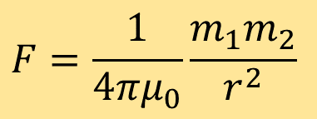

Magnetic Force and Magnetic Field
Force of attraction and repulsion
Assume, magnetic poles on the ends of a magnet
Magnet
Force exerted by poles, Coulomb Forces
$$m_{1},m_{2}:Magnetic Pole Strength$$
Poles
$$F=\frac{1}{4πμ_{0}}\frac{m_{1}m_{2}}{r^{2}}$$
$$r:distance between the pole$$
$$μ_{0}:Permeability of the vacuum (4π×{10}^{−7} Hm^{−1})$$
Region where magnetic poles experiences applied force, Magnetic Field
Magnetic field can be produced by: magnetic poles or electric current

Slide 3
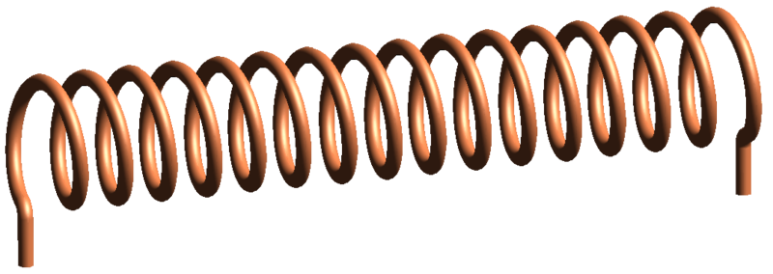
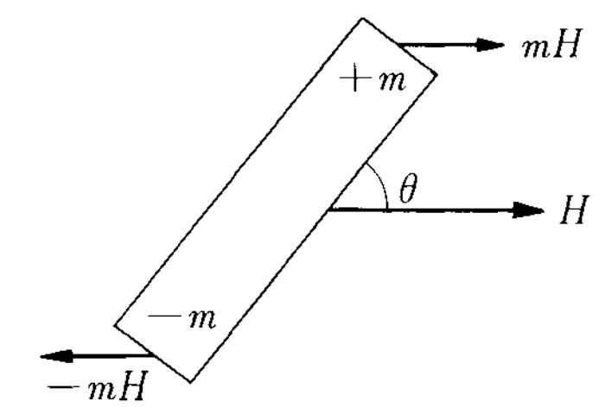
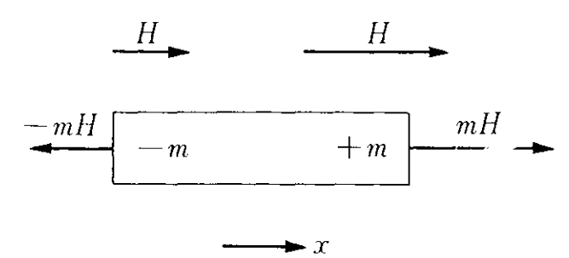
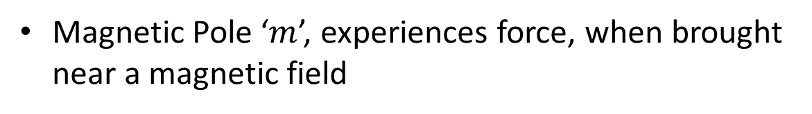



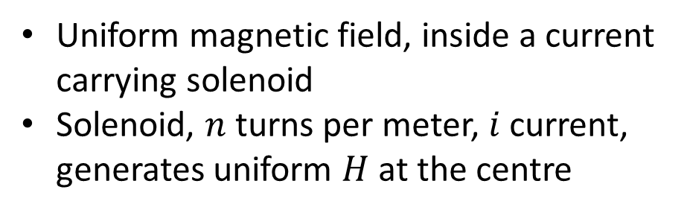





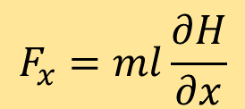
Magnetic Field
$$H$$
Uniform magnetic field, inside a current carrying solenoid
Solenoid, $n$ turns per meter, $i$ current, generates uniform $H$ at the centre
$$i$$
$$H=ni$$
$$i$$
Magnetic Pole ‘$m$’, experiences force, when brought near a magnetic field
$$F=mH$$
$$Uniform H$$
$$Non−uniform H$$
$$F_{x}=ml\frac{∂H}{∂x}$$
$$L=−mHl sin⁡(θ)$$
✓Rotational Motion
✗ Translational motion
✗ Rotational Motion
✓Translational motion

Slide 4
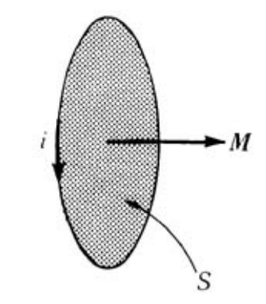


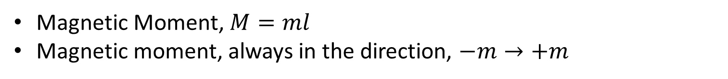



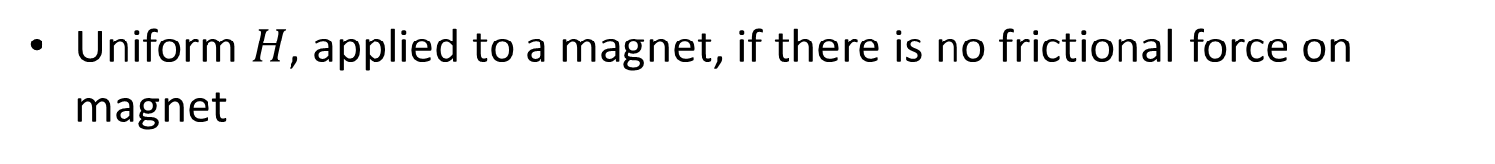
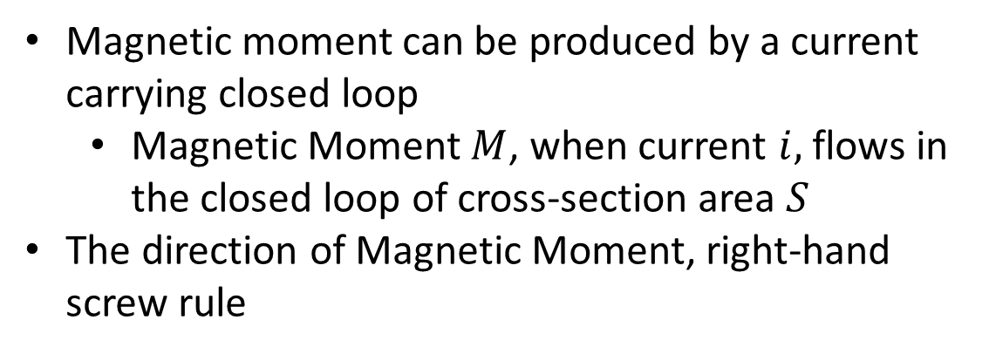
Magnetic Moment
Magnetic Moment, $M=ml$
Magnetic moment, always in the direction, $−m→+m$
$L=−mHl\sin\left(θ\right)→−MHsin(θ)$
$$L=−M×H$$
Uniform $H$, applied to a magnet, if there is no frictional force on magnet
$$U=−MHcos(θ)$$
$$U=−M.H$$
Magnetic moment can be produced by a current carrying closed loop
Magnetic Moment $M$, when current $i,$ flows in the closed loop of cross-section area $S$
The direction of Magnetic Moment, right-hand screw rule
$$M=μ_{0}iS$$

Slide 5
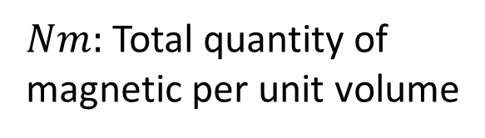
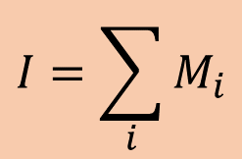

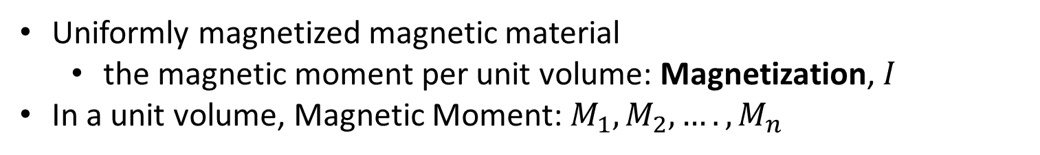
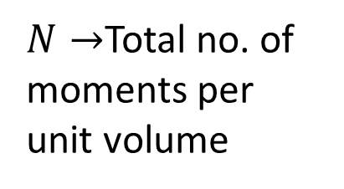
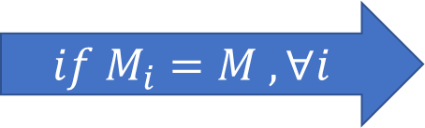
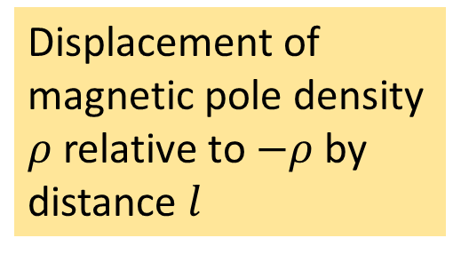


Magnetization
Uniformly magnetized magnetic material
the magnetic moment per unit volume: Magnetization, $I$
In a unit volume, Magnetic Moment: $M_{1}, M_{2}, …., M_{n}$
$$I=\sum_{i}{M_{i}}$$
$$if M_{i}=M , ∀i$$
$N→$Total no. of moments per unit volume
$$I=NM$$
Another interpretation of magnetization,
Displacement of magnetic pole density $ρ$ relative to $−ρ$ by distance $l$
$$I=Nml$$
$$I=ρl$$
$Nm:$ Total quantity of magnetic per unit volume

Slide 6
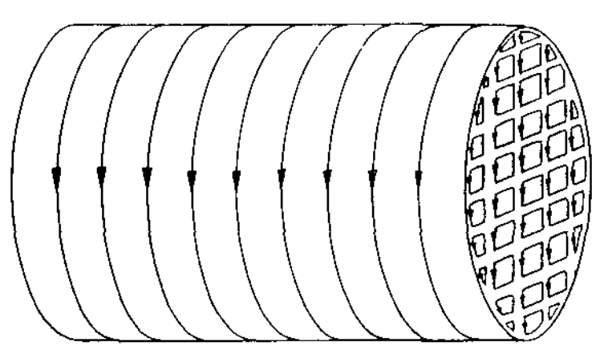

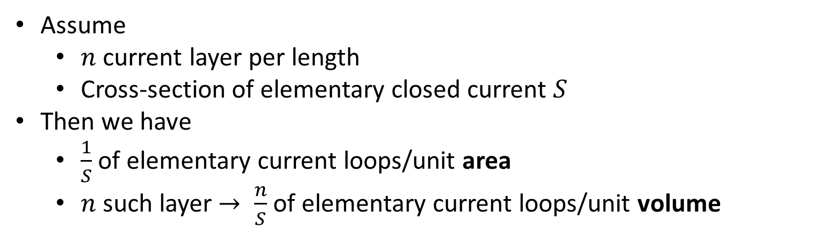




Magnetization
Suppose that magnetic material is filled with many elementary closed current loops
Neighbouring current cancels each other
Only the surface current remains
Assume
$n$ current layer per length
Cross-section of elementary closed current $S$
Then we have
$\frac{1}{S}$ of elementary current loops/unit area
$n$ such layer $→ \frac{n}{S}$ of elementary current loops/unit volume
$$N=\frac{n}{S}$$
$$M=μ_{0}iS$$
$$I=NM$$
$$I=Nμ_{0}iS$$
Magnetization of a closed current loop
Magnetization
$$I=μ_{0}ni$$

Slide 7
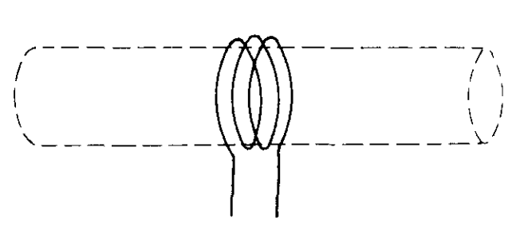

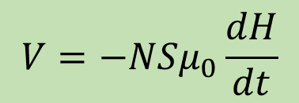
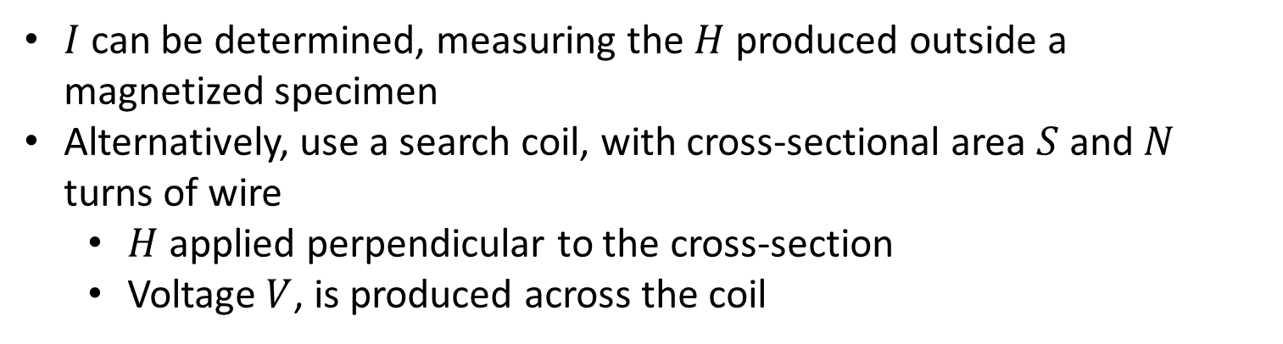
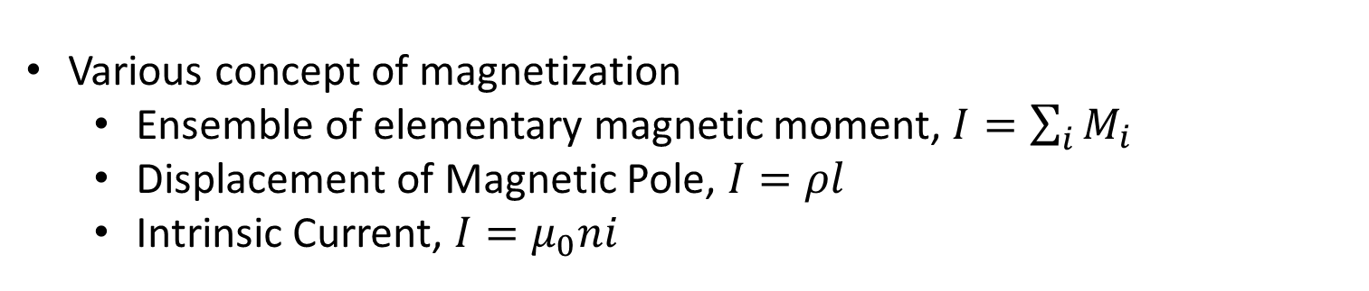
Magnetization
$$I=μ_{0}H$$
Comparing, $I=μ_{0}ni$ and $H=ni$
Various concept of magnetization
Ensemble of elementary magnetic moment, $I=\sum_{i}{M_{i}}$
Displacement of Magnetic Pole, $I=ρl$
Intrinsic Current, $I=μ_{0}ni$
$I$ can be determined, measuring the $H$ produced outside a magnetized specimen
Alternatively, use a search coil, with cross-sectional area $S$ and $N$ turns of wire
$H$ applied perpendicular to the cross-section
Voltage $V$, is produced across the coil
$$V=−NSμ_{0}\frac{dH}{dt}$$
Acc. to the Law of Electromagnetic Induction

Slide 8

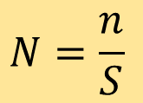
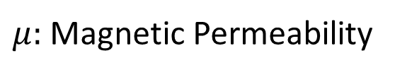
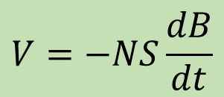

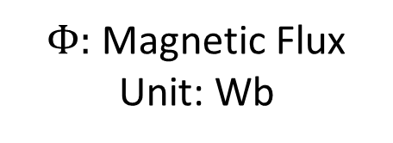

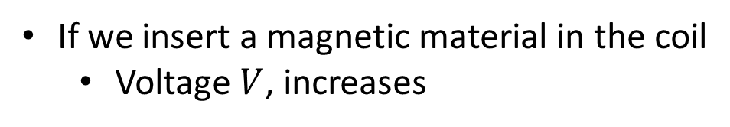
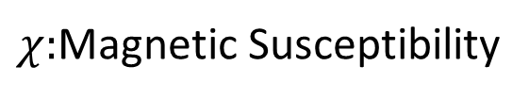

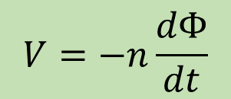
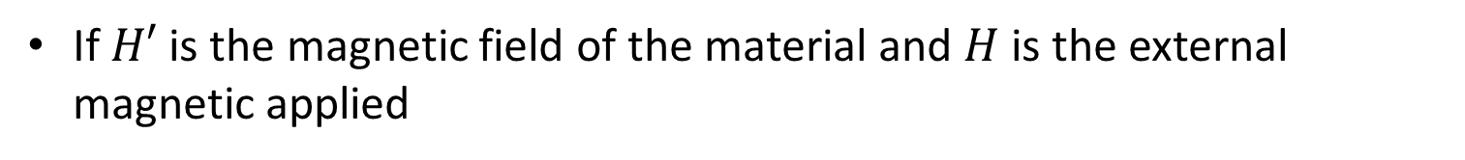


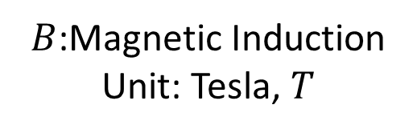
Magnetization
If we insert a magnetic material in the coil
Voltage $V$, increases
$$V=−NS\frac{dB}{dt}$$
$B$:Magnetic Induction
Unit: Tesla, $T$
If $H′$ is the magnetic field of the material and $H$ is the external magnetic applied
$$B=I+μ_{0}H$$
$$B=μ_{0}(H+H^{′})$$
$$I=μ_{0}H′$$
Product of $B$ and $S:$ Magnetic Flux
$$Φ=BS$$
$Φ:$ Magnetic Flux
Unit: Wb
$$N=\frac{n}{S}$$
$$V=−n\frac{dΦ}{dt}$$
$B=I+μ_{0}H$, We can say that $I$ is proportional to $H$
$$I=χH$$
$χ:$Magnetic Susceptibility
$B=\left(χ+μ_{0}\right)H=μH$
$μ:$ Magnetic Permeability

Slide 9
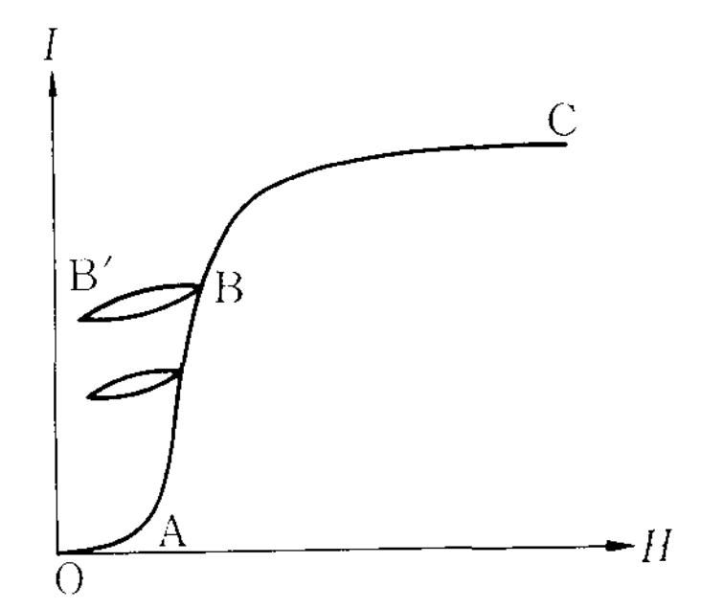
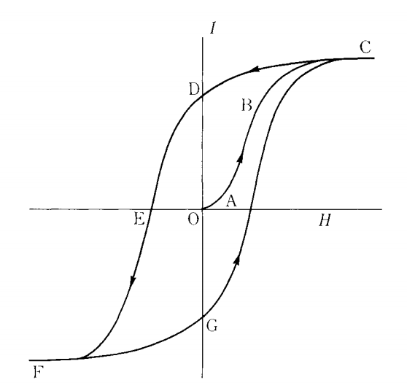
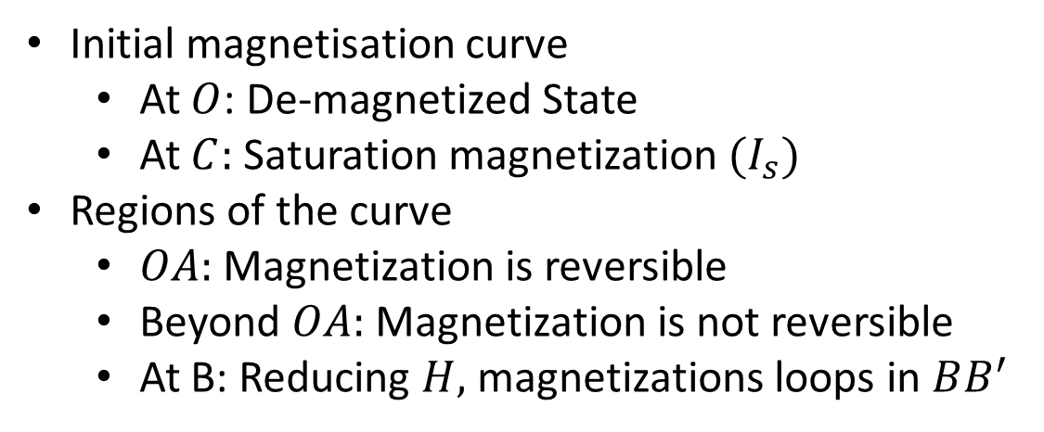
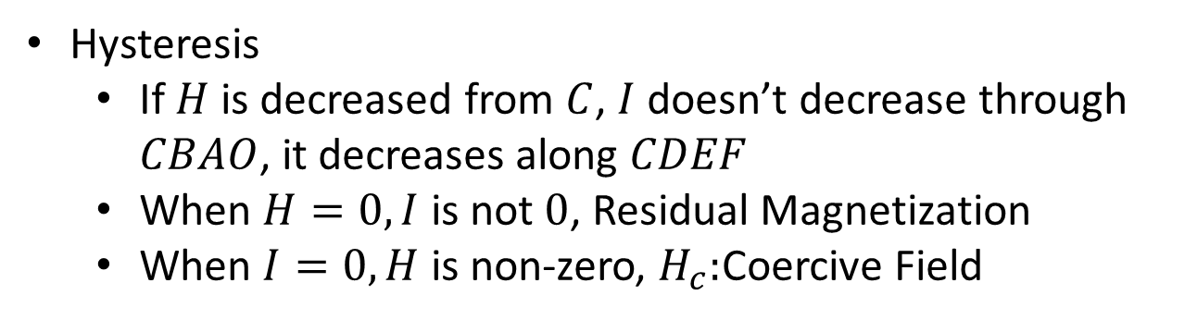
Hysteresis
Ferromagnetic materials can be highly magnetized by magnetic field
Magnetization changes by changing magnetic field
Initial magnetisation curve
At $O$: De-magnetized State
At $C:$ Saturation magnetization ${(I}_{s})$
Regions of the curve
$OA:$ Magnetization is reversible
Beyond $OA:$ Magnetization is not reversible
At B: Reducing $H,$ magnetizations loops in $BB^{′}$
Hysteresis
If $H$ is decreased from $C$, $I$ doesn’t decrease through $CBAO$, it decreases along $CDEF$
When $H=0, I$ is not $0$, Residual Magnetization
When $I=0, H$ is non-zero, $H_{c}:$Coercive Field

Slide 11
Physics of Ferromagnetism
Weekly Presentation
Ch1. Magnetostatic Phenomena,
Physics of Ferromagnetism (1997), Chikazumi
Khritish Kumar Behera 17125
EECS Dept., IISER Bhopal
1st October 2021

